Slide 1

Creating a SPAA – Template Process
Reviewed 11/30/2023
Creating a SPAA for clients
Open Client Files
Click Create Template
Choose SPAA and click Create template
Verify and enter all applicable information (ie. Date of Debit on page 4 should be NEXT draft date, include authorized contact if there is a co-client)
Select Print and save as a PDF
Send the form to the client via OneSpan (best practice is to do this and get it returned while client is on the line.
Submit applicable request
Info change if client is changing bank info
Global validation if client is signing SPAA for validation purposes
Upload form to Request Files and Crush FTP as a PDG file
*If client is from CO or WA – use manual process on next slide*

Slide 2
Creating a SPAA – Template Process
Reviewed 11/30/2023
Creating a SPAA for clients
Open Client Files
Click Create Template
Choose SPAA and click Create template
Verify and enter all applicable information (ie. Date of Debit on page 4 should be NEXT draft date, include authorized contact if there is a co-client)
Select Print and save as a PDF
Send the form to the client via OneSpan (best practice is to do this and get it returned while client is on the line.
Submit applicable request
Info change if client is changing bank info
Global validation if client is signing SPAA for validation purposes
Upload form to Request Files and Crush FTP as a PDG file
*If client is from CO or WA – use manual process on next slide*

Slide 3
Creating a SPAA – Manual Process
Creating a SPAA using Template
Download blank SPAA uploaded in SharePoint (CO or WA use required SPAA form for these state)
Fill in client information - Example
Verify and enter all applicable information (ie. Date of Debit on page 4 should be NEXT draft date, include authorized contact if there is a co-client)
Select Print and save as a PDF
Send the form to the client via OneSpan (best practice is to do this and get it returned while client is on the line.
Submit applicable request
Info change if client is changing bank info
Global validation if client is signing SPAA for validation purposes

Slide 4
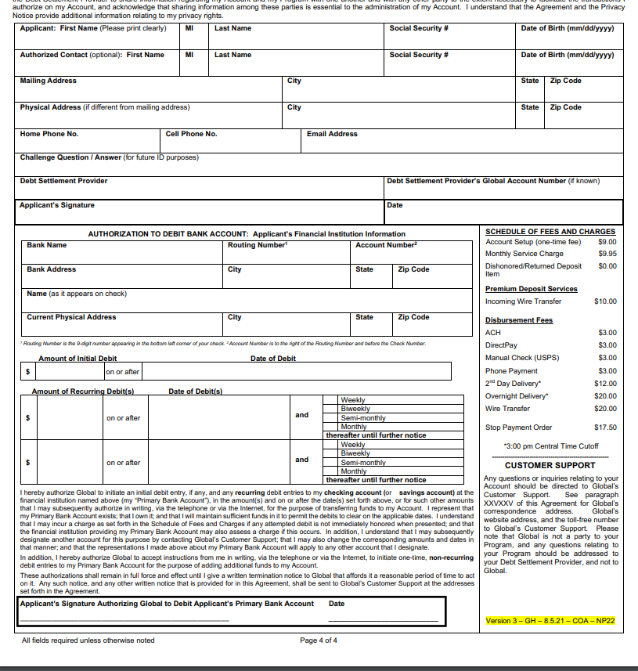


If completing a manual SPAA ensure it is filled out correctly

Slide 9
Exceptions
If an exception is made for a client to mail in their checks, they still need to signa a SPAA for their drafts to display in the calc for negotiations
SPAA should include “Lockbox” for the bank name with nine “1s” for the routing number and twelve “1s” for the account number.
If client is requesting to draft form a Non-Client Bank account
A Non-Client Auth to Debit (ATD) form needs to be sent to be filled out and signed by the Non-Client to authorize drafts.
Add the Non-Client is to be listed as the authorized contact.
The client will still sign the SPAA in all sections.

